Slide 1
PUBP309: EDUCATION POLICY
Shivakumar Jolad
FLAME University
Higher education History and structure

Slide 2
Brief history-RECAP

Slide 3
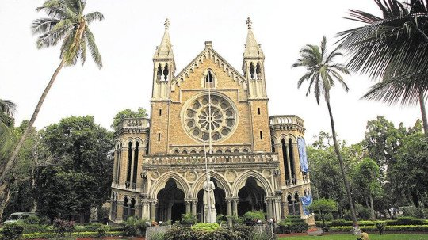

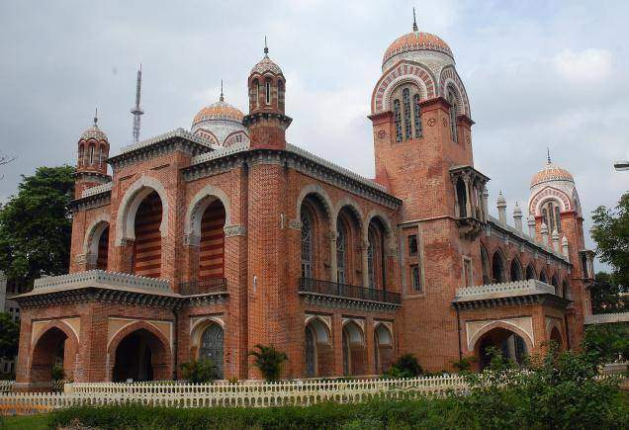
University of Bombay
University of Madras

Slide 4
Establishment of Universities
The Despatch recommended the establishment of universities in the three Presidency towns of Calcutta, Bombay and Madras.
The universities were to be modeled after the London University. These were to have a senate comprising of a Chancellor, a Vice-Chancellor, and fellows who were nominated by the Government.
The Universities would confer degrees to the successful candidates after passing the examinations, (Science, Arts or Commerce) conducted by the Senate.
The universities were to recognize departments not only of English but also of Arabic, Sanskrit and Persian, as well as law and civil engineering.
Affiliation to university was not limited by geographical location. Calcutta University- catered to Bengal, Assam, and Ceylon.
Notes:
Purpose was to award degrees to deserving candidates in Arts, Science, Commerce,
Modeled: Chancellor (Governor), Vice Chancellor, Members. Total at least 30. fellows appointed for life.

Slide 5
Affiliated colleges
Colleges were given Grant in Aid (most widely prevalent method for expansion of education)
Hindu College- > Presidency College; Madras High school-> Presidency college at Madras
University College- Lahore-> Panjab University, Munir Central College-> Allahabad University
Some Indians set up colleges themselves: Canning College-by Oudh talukdars, Lucknow- > Lucknow university, Mohammadian Anglo Oriental Colleges (1875)-> Aligarh Muslim University
Rajkot College, Mayo College- Ajmer., Daly College, Indore
Missionary college: St Xavier College- Calcutta (1860), Bombay (1869), St Stephens College – Delhi (1882),
1876: Indian Association of Cultivation of Science (IACS)- Mahendra Lal Sarcar

Slide 6
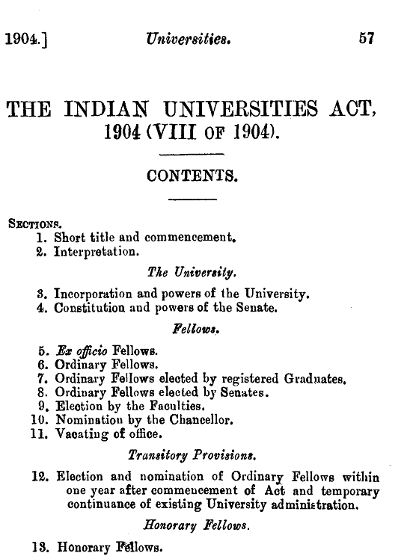
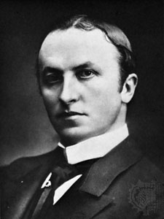
Indian University Act 1904
Universities were empowered to appoint their own staff including the teaching staff
Rules pertaining to affiliation of Colleges to a University were made stricter
Tight command and Control of Universities
Government was empowered to modify the rules framed by the Senate
Governor-General in Council was authorized to define the territorial jurisdiction of the Universities.
Halted expansion of Universities ; One of the most controversial legislation- widespread opposition by Indians; Curzon was regarded as a person for doom of higher education
Lord Curzon
(1859 –1925)
Notes:
1902 : 6 member commission was established. Only one Indian member- Syed H Bilgrami
Widespread opposition to the recommendations by Indians (especially Bengali’s).
1903- Bill was introduced by Lord Raleigh.
Faced stiff opposition from G K Gokhale, and Ashutosh Mukhopadhyaya
March 1904 the Indian Universities Act passed into law
Grant of Rs 5 lakhs a year for the universities to implement the provisions of the law
Dissent came as there was no Hindu representative
Surendranath Banerjea (dismissed ICS officer and member of congress) opposed the committee. Many Hindus supported him.
Curzon bent to the popular opinion and sent request for including 5 local commissioners as members (Ashutosh Mukhopadhyay- Bengal, Sankaran Nair-Madras, Chandavarkar- Bombay, Lewis and Bell-NWP)

Slide 7
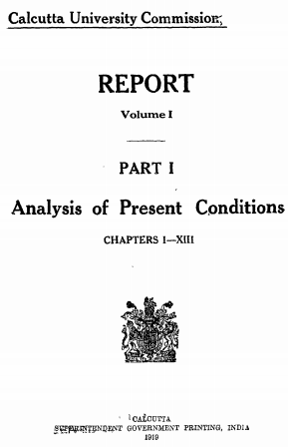
Calcutta University Commission 1917-19
Also known as Saddler Commission (Sir Michale E Saddler of Leeds)
13 Volumes – each 400-600 pages!!
Free the university from rigid government control imposed by Lord Curzon’s IUA.
Separation of intermediate colleges from Degree Colleges..
Use of mother tongue in intermediate colleges
Honors courses as distinct from pass course, should be opened in the universities.
Inter-University board to coordinate activities of various Indian Universities
Changed character of University organization in India –creating bodies like: board of studies, academic council, …
Selection committees (including outside experts) to hire faculty.
Notes:
It was commissioned to inquire about condition of Univ of Calcutta and suggest policy for reforms. Members: Dr. Gregory, Prof. Ramsey Muir, Prof. Ashutosh Mukherjee (VC of Calcutta), Sir. Phillip Hartog (educationalist) etc.
Studied problems of secondary education as lays the foundation and directly links to the entry to colleges. – Recommended formation of board of secondary education (SSLC, Intermediate board etc)

Slide 8
Creation of New Universities 1917-22
No new universities from 1887-1916.
8 new Universities in a short period
Universities in
Mysore- 1916 (For Mysore and Coorg)
Patna – 1917 (For Bihar and Orissa)
BHU (Benaras)- 1917 , Pt. Madan Mohan Malaviya
Aligarh – 1920 (Mohomedian Anglo-Oriental College, - Sir Syed Ahmed Khan)
Dacca- 1920
Lucknow- 1920
Osmania- 1918 (From Hyderabad Nizam)- Urdu medium University
Delhi -1922

Slide 9
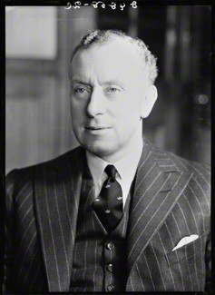
Sargent plan
Sir John Sargent, the Educational Adviser to the Government of India was asked to prepare a comprehensive report on education: ‘Plan for post-war educational reconstruction in India’.
It was the first attempt to develop a National System for Education for post independent India. Full fledged educational plan for the future educational reconstruction in India
Presents a comprehensive picture of education in our country at that period of time
The duration of degree course should be of 3 years.
Adequate financial assistance must be provided for poor students
Emphasis should be given on establishing a high standard in post-graduate studies and in pure applied research.
Sir John Philip Sargent
© National Portrait Gallery, London

Slide 10
Implementation of Sargent Plan Recommendation
In 1945 an education department was established at the centre to increase administrative efficiency.
40 crores of rupees were given to the provincial Governments for implementing certain aspects of the scheme in their areas.
The Provincial Governments were advised to make five year plans for education.
Decided that the scheme should be implemented within 16 years instead of 40 year.
According to the recommendations of the committee University Grants Committee was constituted in 1945 which later on became University Grants Commission in 1956.
Efforts were made for adult education and also for improving the economic condition of teachers.
The committee of polytechnic school and the All India Technical Education Committee were established in Delhi.
http://www.kkhsou.in/main/education/sargent_report.html

Slide 11
Post Independent INDIA

Slide 12
State of HIGHER Education at India’s Independence
Population in 1947 : around 406 million (India + Pakistan combined)
Higher Education:
15 Universities, 16,000 students , expenditure – 2.03 crores
300 Arts and Science Colleges, Pupils: 96,000 , expenditure- 3.53 crores
16 engineering and technical colleges, 72,000 students; expenditure – 2.73 crores
S C Ghosh
Notes:
Elementary Education:
Elementary schools: 1.72 lakhs (decline from 1.89 lakhs in 1936-37)
Number of pupils : 1.3 crore (increase from 1.05 crore in 1937)
Expenditure: 15.5 crores
Secondary Education:
Number of schools: 17,250 (Increase from 13,400 in 1936-37)
Number of Pupils: 36.06 lakhs (Increase from 23.93 lakhs in 1936-37)
Expenditure: 17.9 crores

Slide 13

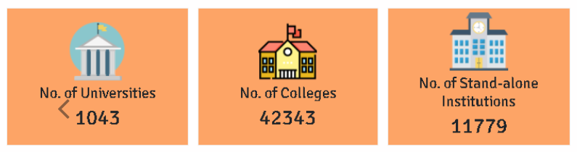
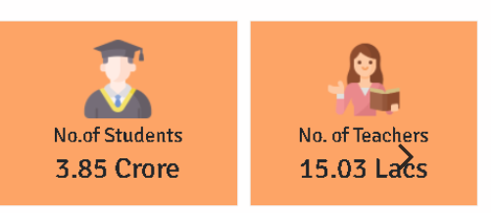
https://aishe.gov.in/aishe/home

Slide 14


Slide 15
Education in post indpendent india (Union level)
Nalini Ranjan Sarkar Committee- to Set up IITs- 1946
University Grants Commission (Radhakrishnan) – UGC – 1948-49
Secondary Education Commission, 1952-53 (Dr. A L Mudaliar committee)
1962: IIT Act
Amendment in Constitution to put Education in concurrent list(1976)
National Policy on Education 1986 and POA 1992
State Education Acts, Educational Institutions. 2010:
National Knowledge Commission
Yash Pal Committee: Report of the Committee to Advise on 'Renovation and Rejuvenation of Higher Education- 2010
2013: Anil Kakodkar Committee: Taking IITs to Excellence and Greater Relevance
2020: National Education Policy

Slide 16
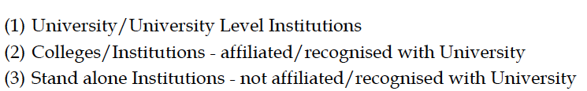
Categories of Institutions on Higher Learning
AFTER INDEPENDENCE
BEFORE INDEPENDENCE
Affiliated College
Constituent College
University
Autonomous College
Centre of Excellence: IIXs
Affiliated College
Constituent College
University

Slide 17
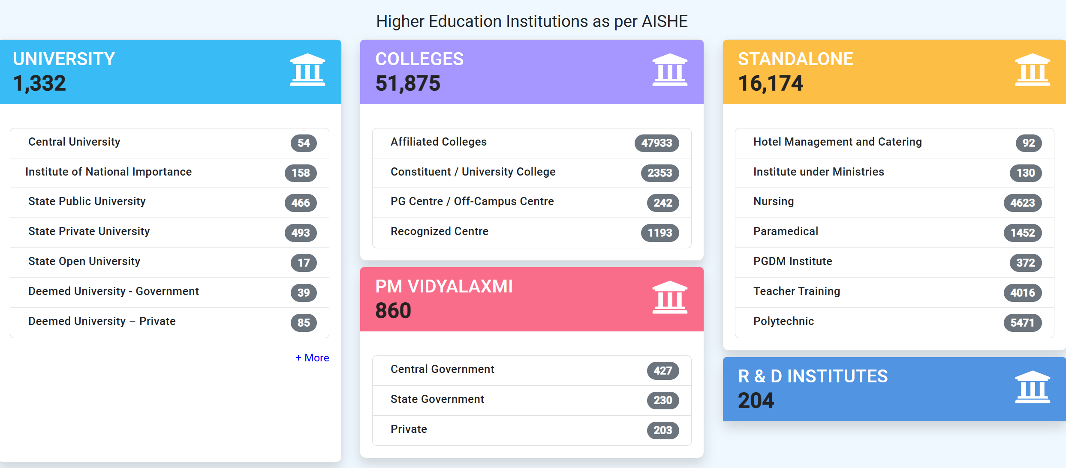
AISHE recent data

Slide 18
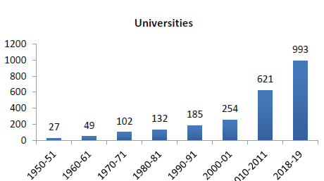
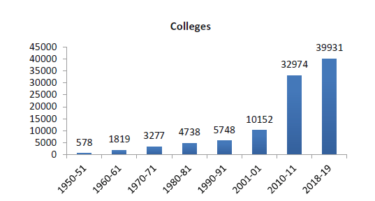
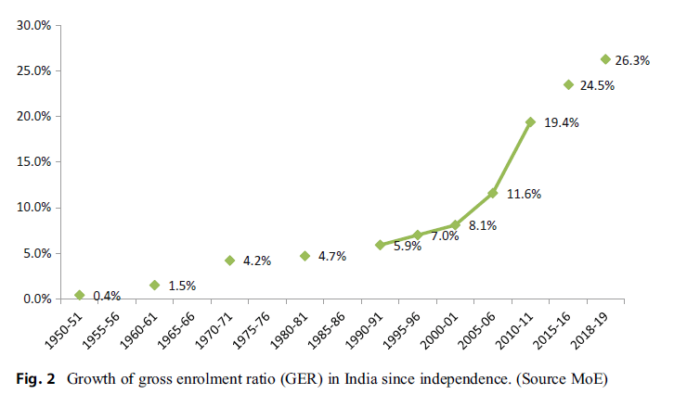
India’s Higher Education in Numbers
AISHE (2019-19)
993 Universities
39,931 Colleges
37.4 million students
1.4 million faculty (AISHE 2018–19)
GER Growth Over Time
2005: GER 10%
2019: GER 26.3%
Target 2035 (NEP): GER 50%

Slide 19
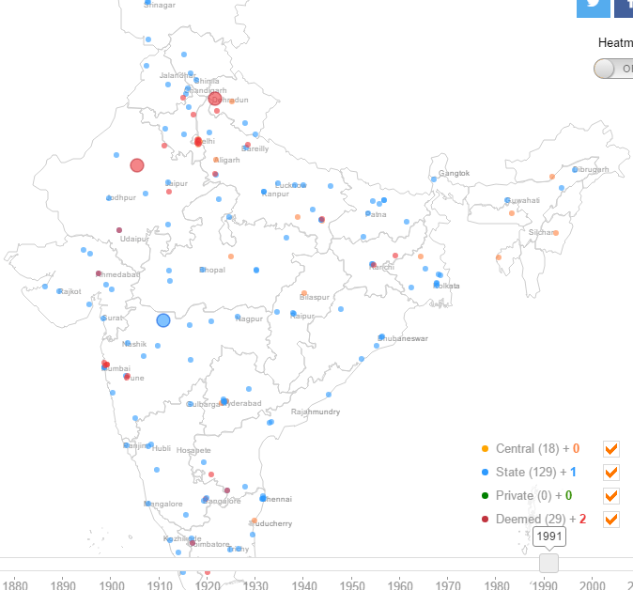
Higher education: Universities
1991
Central: Public universities formed by passing a Central act.
State: Public universities formed by passing a State act.
Private: Universities established through a state or central act by a sponsoring body which can be a registered Society, Trust or Non-profit Company.
Deemed to be : “a high-performing institution, which has been so declared by Central Government under Section 3 of the University Grants Commission (UGC) Act, 1956
MHRD control: Institutions of National Importance (IITs, NITs, AIIMS, etc.) and Premier Institutes of Management (IIMs)
Demystifying Higher Education in India,
Thomas Manuel , The Wire 08/07/2015
Notes:
Central: Public universities formed by passing a Central act.
State: Public universities formed by passing a State act.
Private: Universities established through a state or central act by a sponsoring body which can be a registered Society, Trust or Non-profit Company. Unlike public universities, they do not have the powers to affiliate colleges but they do have license to set their own criteria for admission, syllabus, etc.
Deemed: The UGC website defines a Deemed University as “a high-performing institution, which has been so declared by Central Government under Section 3 of the University Grants Commission (UGC) Act, 1956”. They can be either public or privately-funded. An example of a public deemed university is the Indian Institute of Science, Bangalore and an example of a private deemed university is Manipal University near Mangalore.

Slide 20
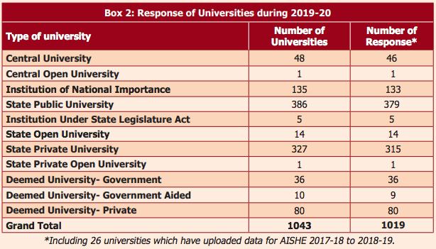
All India Survey on Higher Education 2016-17
Notes:
Universities focusing on a particular discipline
like Agriculture, Ayurvedic, Medicine,
Technical, Law, Forensic Science, etc.
► Deemed to be University (Full Fledged & De-novo)
► Open University
► Private University (PPP & 100% self financed)
► Language University
► Raksha University
► Children University
► Sports University
► Yoga University, etc.

Slide 21
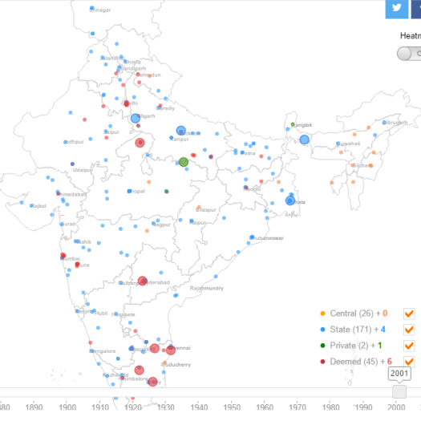
1991
2001
Demystifying Higher Education in India,
Thomas Manuel , The Wire 08/07/2015

Slide 22
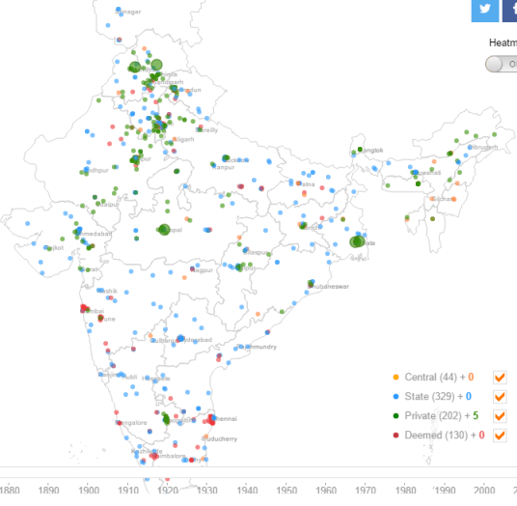
2001
2011
Demystifying Higher Education in India,
Thomas Manuel , The Wire 08/07/2015

Slide 23
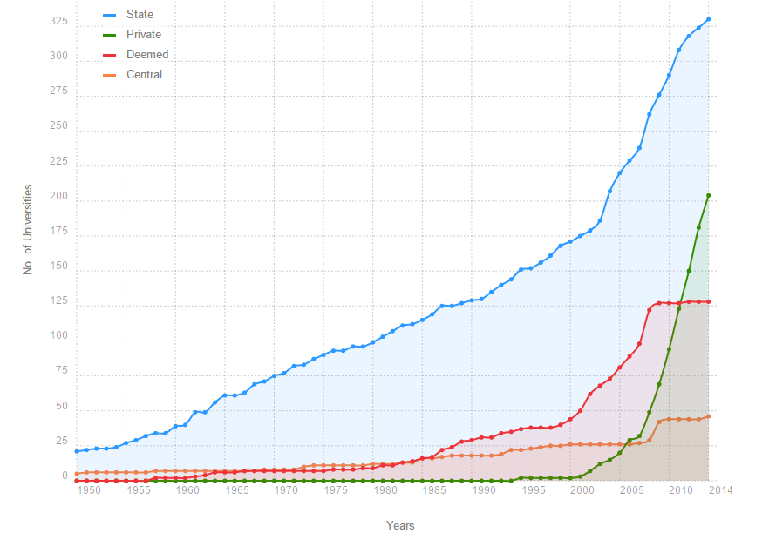
STATE UNIVERSITIES-
Growing consistently
DEEMED UNIVERSITIES-
Picked up around 2000 and peak in 2008
PRIVATE UNIVERSITIES-
Sharpest rise
Demystifying Higher Education in India, Thomas Manuel , The Wire 08/07/2015

Slide 24
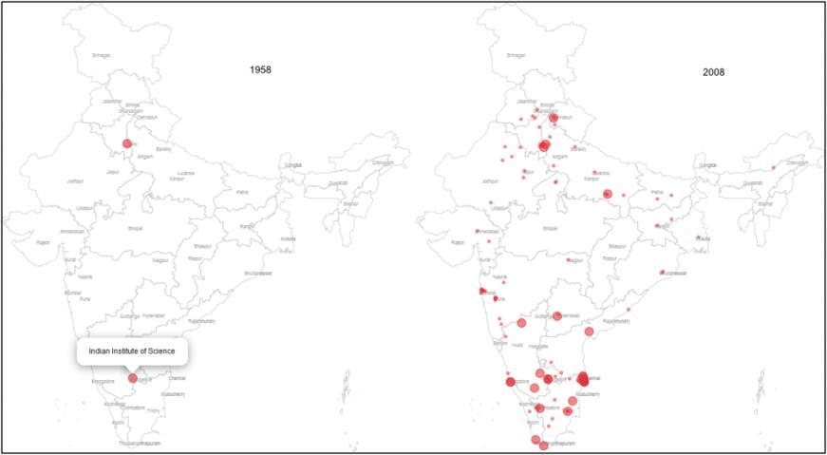
1958 v. 2008: The changing intent of deemed universities?

Slide 25
Projecting higher education scenario

Slide 26
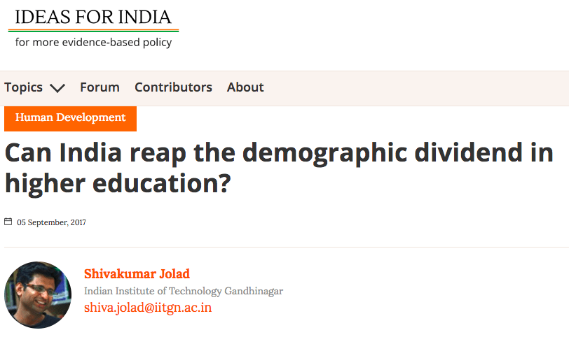

Slide 27
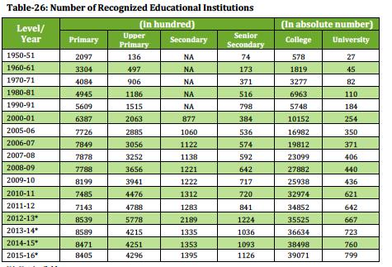

Slide 28
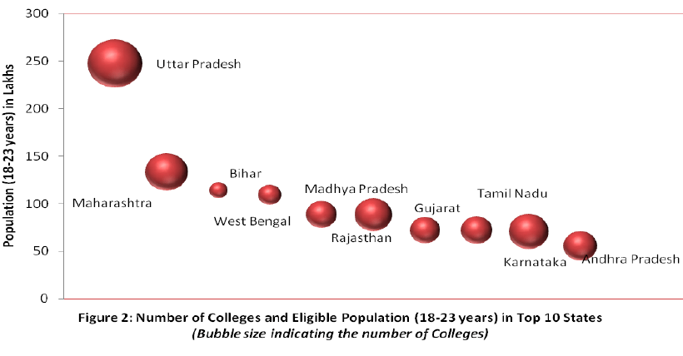

Slide 29
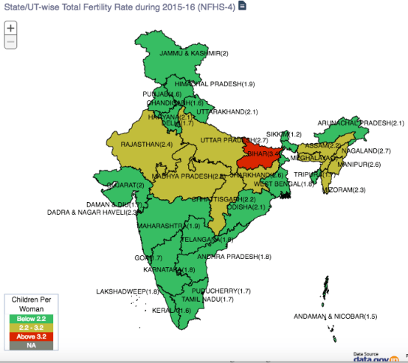
TOTAL FERTILITY RATE
The TFR is an indicator of the number of children a woman is likely to have in her lifetime, given the current fertility rates.
India's Total Fertility Rate (TFR) is 2.2
Median age of 24, more than half of India's population is below 25 years
India is entering the final stage of demographic transition. Replacement level TFR of 2.1 is essential for population stabilisation
NFHS 4, 2014-15
https://community.data.gov.in/stateut-wise-total-fertility-rate-during-2015-16-nfhs-4/

Slide 30
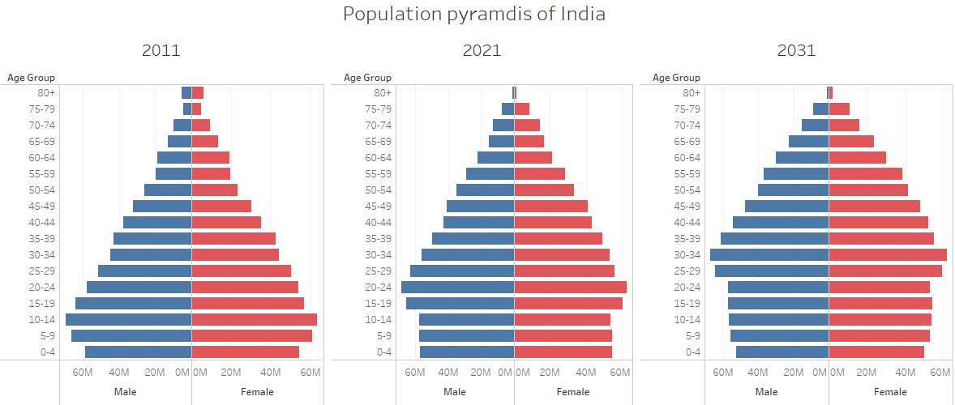
forecasting the young population- INDIA
Census 2011 and Sample Registration Survey (SRS) 2014-2015, along with models of fertility decline in states

Slide 31
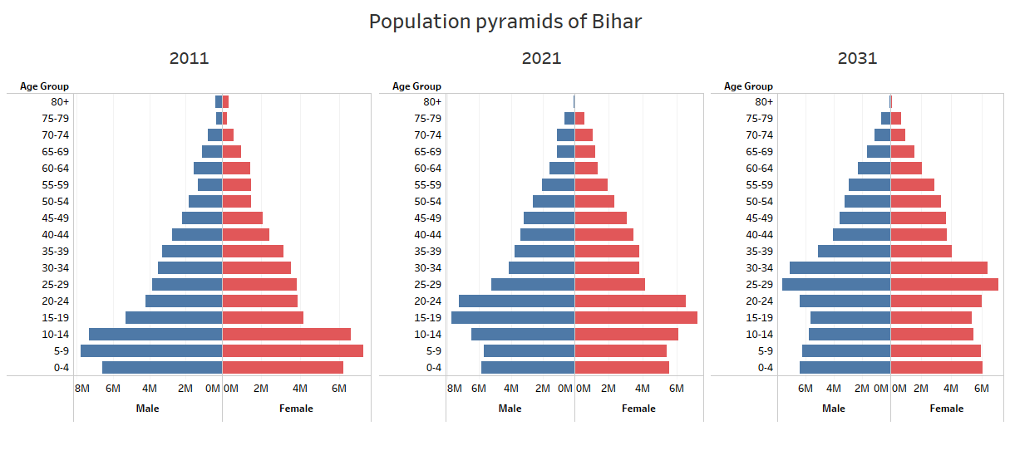
BIHAR POPULATION

Slide 32
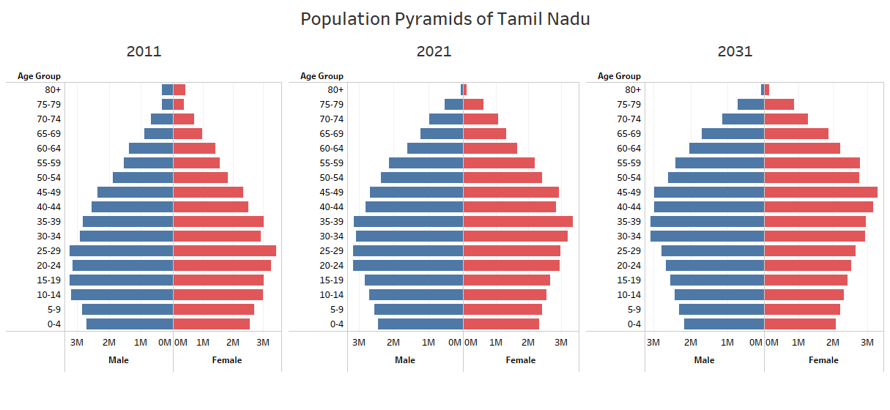
TAMIL NADU

Slide 33
BIHAR and TAMILNADU: Age GROUPS
Bihar: By 2021, the higher education age group of 18-23 years –will increase by 57% from 11.4 million to 17.9 million.
Tamil Nadu, its population in the higher education group will decline from 7.5 million in 2011 to 5.9 million in 2031.

Slide 34
18-23 years: Education and labor force
For a long time in India, the 18-23 age group meant entry into the labour force.
As recently as 2001, only one out of 10 in this age group received any college education.
India's Gross Enrolment Rate (GER) in higher education more than doubled from mere 11% in 2001 to 25% in 20152.
There are currently around 799 universities, 39,071 colleges, and 11,923 stand-alone institutions (not affiliated with universities) (AISHE, 2015-16).
Among the large states, Delhi has the highest GER of 45.4%, and Bihar has the lowest GER of 14.3%

Slide 36
Gross Enrollment RATIO in HIGHER ED- across states

Slide 37
TOTAL FERTILITY RATE
The TFR is an indicator of the number of children a woman is likely to have in her lifetime, given the current fertility rates.
India's Total Fertility Rate (TFR) is 2.2
Median age of 24, more than half of India's population is below 25 years
India is entering the final stage of demographic transition. Replacement level TFR of 2.1 is essential for population stabilisation
NFHS 4, 2014-15
https://community.data.gov.in/stateut-wise-total-fertility-rate-during-2015-16-nfhs-4/

Slide 38
forecasting the young population- INDIA
Census 2011 and Sample Registration Survey (SRS) 2014-2015, along with models of fertility decline in states

Slide 39
BIHAR POPULATION

Slide 40
ACCESS and TYPE OF HIGHER EDUCATION
 | Access |  |  | Type of Institution
State/Country | Colleges per million students | Enrolment per college | Number of universities | Engineering /technology | Medical | Private unaided (%)
India | 280 | 721 | 799 | 2,250 | 841 | 64
Karnataka | 500 | 438 | 52 | 164 | 139 | 67.6
Bihar | 70 | 2,142 | 22 | 26 | 17 | 13
Source: AISHE-2015-2016

Slide 41
Current and projected enrolment rate in Bihar and Karnataka
 | Current enrolment (in mn) | Projected enrolment
 |  | At constant GER |  | At 25% GER |  | All- 40% GER
 | 2016 | 2026 | 2031 | 2026 | 2031 | 2026 | 2031
India | 38.8 | 32.6 | 32.6 | 33.3 | 33.3 | 53.2 | 53.2
Karnataka | 1.8 | 1.6 | 1.6 | 1.5 | 1.5 | 2.4 | 2.4
Bihar | 2.4 | 2.1 | 1.9 | 3.8 | 3.3 | 6.0 | 5.3
Source: 2016 data from AISHE-2016
Notes:
Education policymakers and planners both at the Center and the states have to take cognisance of the demographic trends and enrolment patterns across the states while planning and allocating budget. For example, in Delhi, the change in higher education enrolment will be driven mainly by migration of youth from across India. In Tamil Nadu, enrolment trends will be driven primarily by an increase in GER rather than demographic change, whereas in Bihar there is enormous scope for expansion both due to demographic change and enrolment rate increase.

